Slide 1

Sprint #2 End Presentation
Notes:
Alex

Slide 2

Goals:
Problem: Going through countless recipe searches and being bombarded with filler text before the actual recipe
Solution: Remove the filler text and quickly search for recipes with only a simple keyword as well as interactive UI for ease of navigation throughout the cooking experience
Notes:
Alex

Slide 3

Sprint #2 Goals
Login Page and the functionalities
Researching/learning the necessary languages for our project
Less than 3 click mindset
Logo commission
Notes:
Dane

Slide 4
Updates
Business Requirement Document
No updates
Product Requirement Document
Updated Sprint Board, Gantt Chart, Burndown Chart, Project Tracker
Notes:
Dane

Slide 5
User Stories
Some user story points were completed for login page functionality
Focus on the login page
Most important user story for this sprint: “As an account user, I want to be able to login to the system so that I can use the features of the system to accomplish what I need”
Notes:
Dane

Slide 6
User Stories
System Admin
As a system admin, I want to be able to add a Guest User so that they can become an Account User. (2 points)
As a system admin, I want to be able to delete an Account User so that Account cannot be used. (2 points)
As a system admin, I want to be able to update the details of my application so that the application will keep updated details always. (2 points)
Guest User
As a guest user, I want to be able to search for recipes so that I can use the feature of the system to search for the recipe and preparation that I need. (34 points)
As a guest user, I want to be able to register for an account so that I can become an Account User and use the Account User’s features. (13 points)
As a guest user, I want to be able to sort the recipes I have searched so that I can view them by multiple categories in order to search for specific ones. (5 points)
Notes:
Dane

Slide 7
User Stories
Account User
As an account user, I want to be able to search for recipes so that I can use the feature of the system to search for the recipe and preparation that I need. (34 points)
As an account user, I want to be able to login to the system so that I can use the features of the system to accomplish what I need. (21 points)
As an account user, I want to be able to reset my password so that I can create a new password to login to the system. (8 points)
As an account user, I want to view my list of recipes so that I can check on the details of my list of recipes. (21 points)
As an account user, I want to be able to add recipes to my list so that I can save the recipe into a list of other recipes for future use. (13 points)
As an account user, I want to be able to delete recipes off my list so that I can get rid of recipes that do not interest me any longer. (8 points)
As an account user, I want to be able to sort the recipes I have searched so that I can view them by multiple categories in order to search for specific ones. (5 points)
Total points from all user stories: 168 points
Planned points for sprint: 40
Completed Points: 40
Notes:
Dane

Slide 8

Code Demo

Slide 9
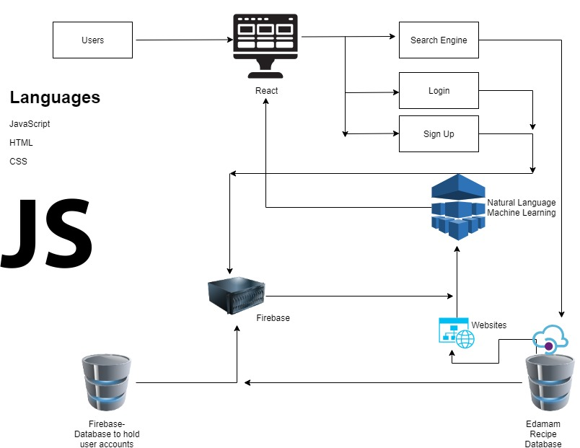
Architecture
React.js used for front-end
User Platforms:
Chrome Extension
Web application
Notes:
Jose

Slide 10
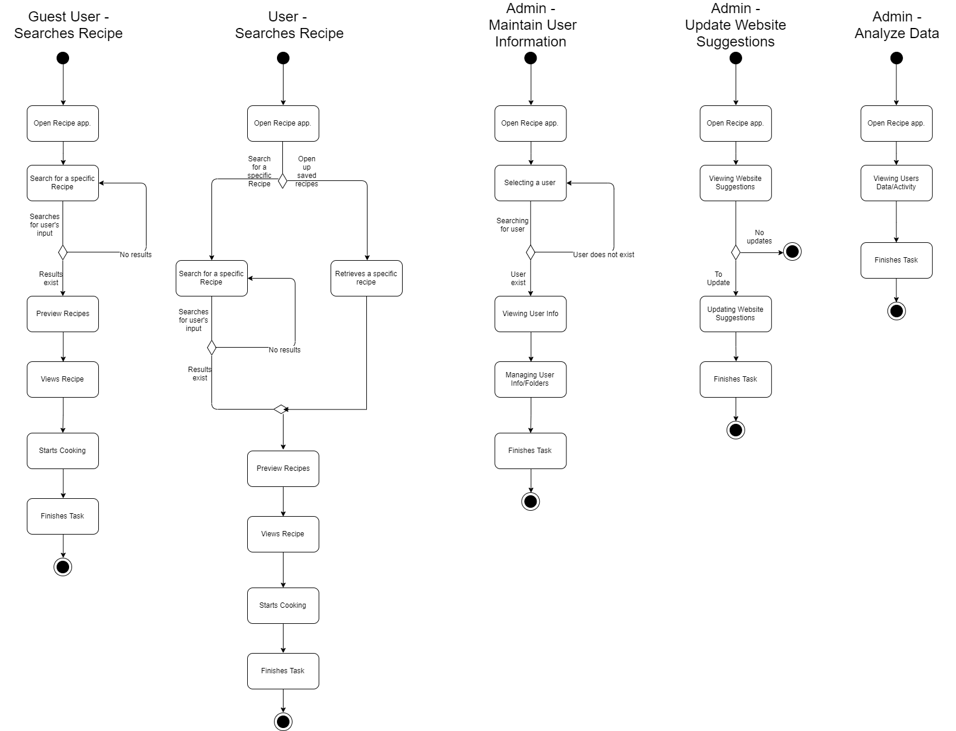
Activity Diagram
Notes:
Alex

Slide 11
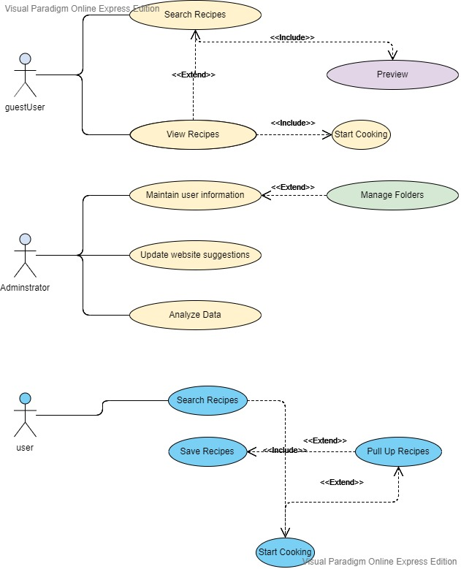
Use Case Diagrams
Notes:
Alex

Slide 12
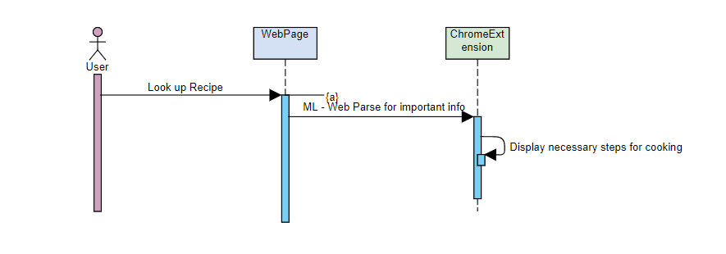
Sequence Diagrams

Slide 13
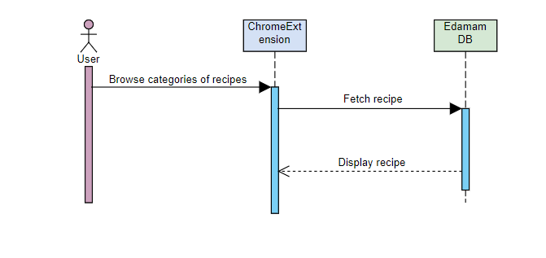
Sequence Diagram

Slide 14
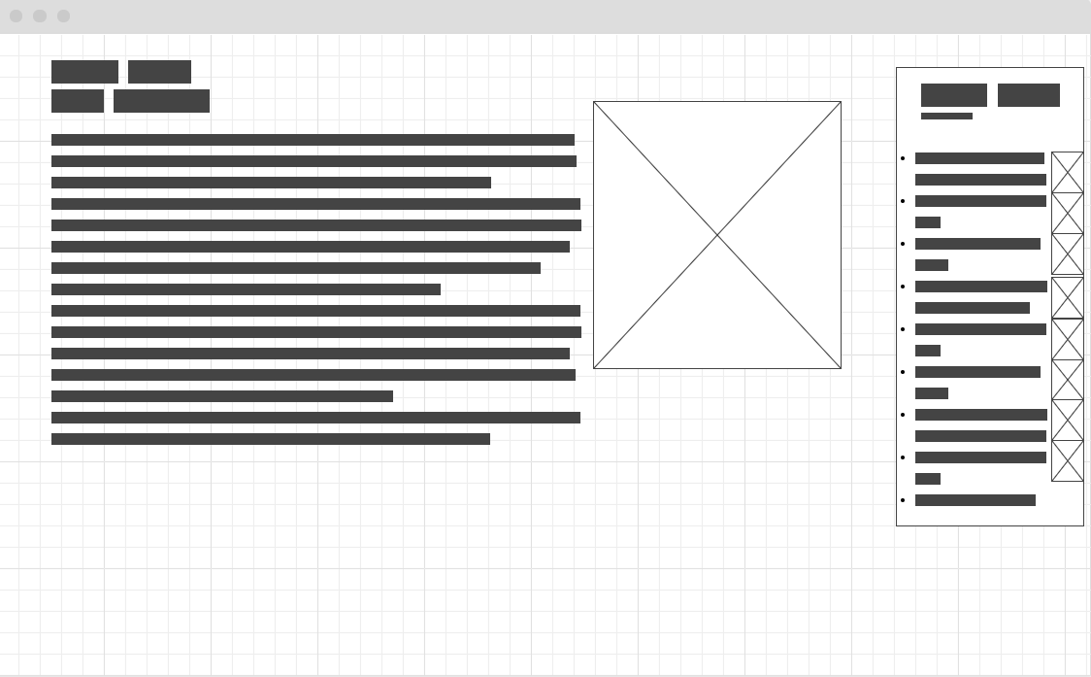
Wireframe

Slide 15
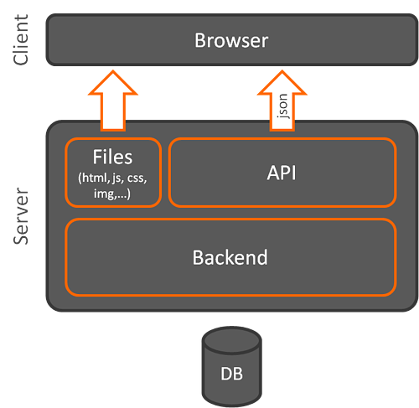
Client Side Architecture
Works in this general model:
Client devices send requests to the server
Server takes upon client requests
Fetch data from the server and returns as HTML
JSON if an API is used
Considerations:
Model-View-View-Model (MVVM)
Model-View-Controller (MVC)
Notes:
Henry

Slide 16

React.js
Reasons for choosing React.js
Recommended by colleagues
Reusability of React Components
Smaller learning scale due to it being a library
Cons:
JSX - Mixture of HTML and JavaScript often creates confusion
High pace of development, new features updated while old features depreciated constantly

Slide 17


Trade-Off Analysis : Front-ends
Pros
Cons
Component Reusability Google support Third-party integrations for better functionalities | Steep Learning curve, difficult to learn
Component Reusability Detailed documentation for ease of learning Very lightweight and easily integratable | Small community due to being new, lack of support High pace of development

Slide 18

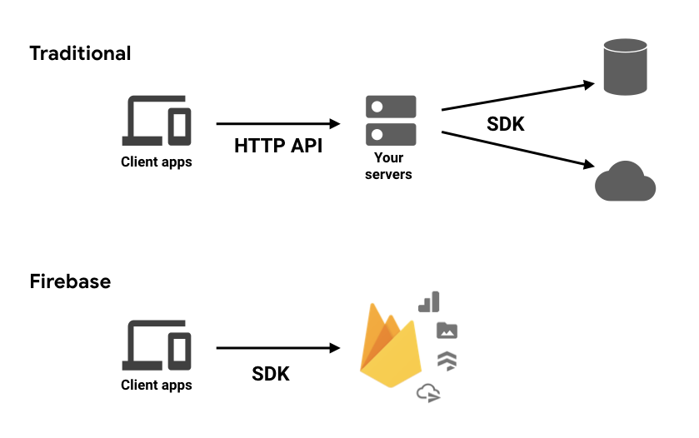
Firebase
Reasons for choosing firebase
Recommended by colleagues
Real-time database - data hosted on cloud and synchronized
Accessibility of Machine Learning
Auth, Email, Hosting, Backend, Uptime automatically provided
Cons:
Less flexibility on queries for complicated items
Dependency and trust on Google
Notes:
Henry

Slide 19


Trade-Off Analysis : Back-end
Pros
Cons
No data capacity - you pay for the amount you use on the cloud Very detailed documentation for ease of learning Array of tools ready to be deployed (ex. Database - Amazon Aurora, analytics) | Price Packages (Developer, Business, Entreprise) No control over environment, dependent on Amazon
Document-oriented NoSQL database for ease of access of indexing Direct use of JSON and JavaScript frameworks Free of cost | Less flexibility in queries (ex. No joins) No support for transactions (updating documents/collections) → risk of duplication of data
Notes:
Henry

Slide 20

Machine Learning
We plan to use our Machine Learning as a way for our user to get recommended recipes based off of their previous viewings and saved recipes if any.
Another incorporation that would like to be implemented is a way for our model to parse cooking websites for recipes as well.
Be able to take out the important info from long paragraphs
No longer using natural language processing model.
Notes:
Jose

Slide 21
Machine Learning
Compare
Put the money in the bag.
Fry the fish for 5 minutes on each side.
How do we know which sentence is related the cooking?
We plan on creating a program that is able to tell if a sentence is related to cooking or not. From there, be able to tell the difference between a recipe or not a recipe.

Slide 22
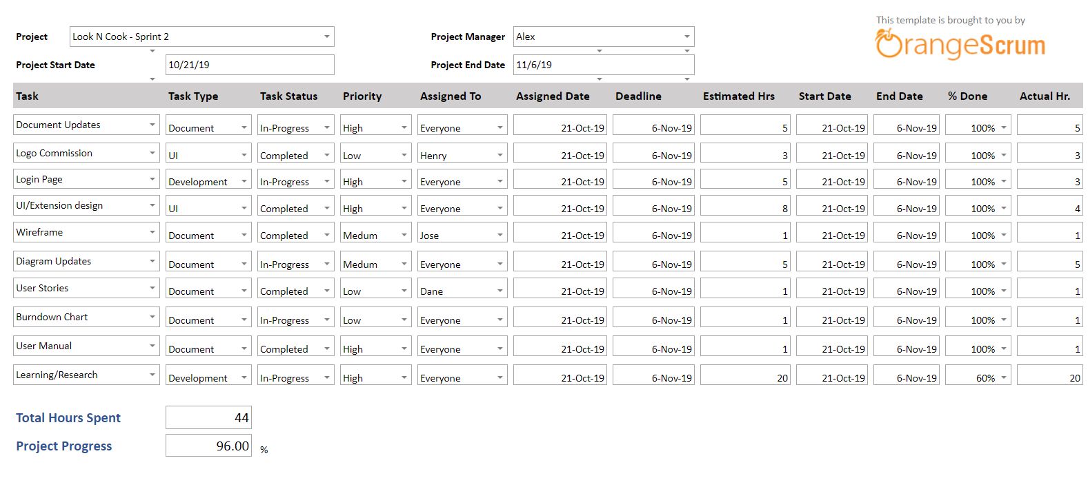
Project Tracker
Notes:
Dane

Slide 23
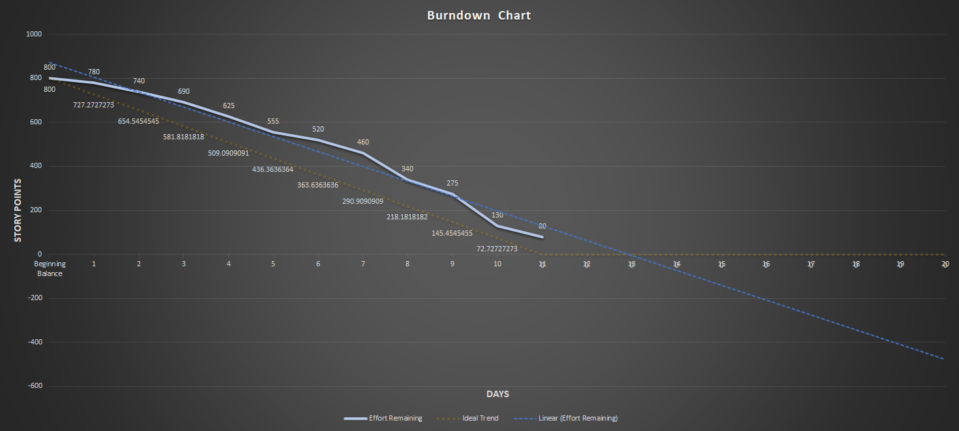
Burndown Curve
Notes:
Jose

Slide 24
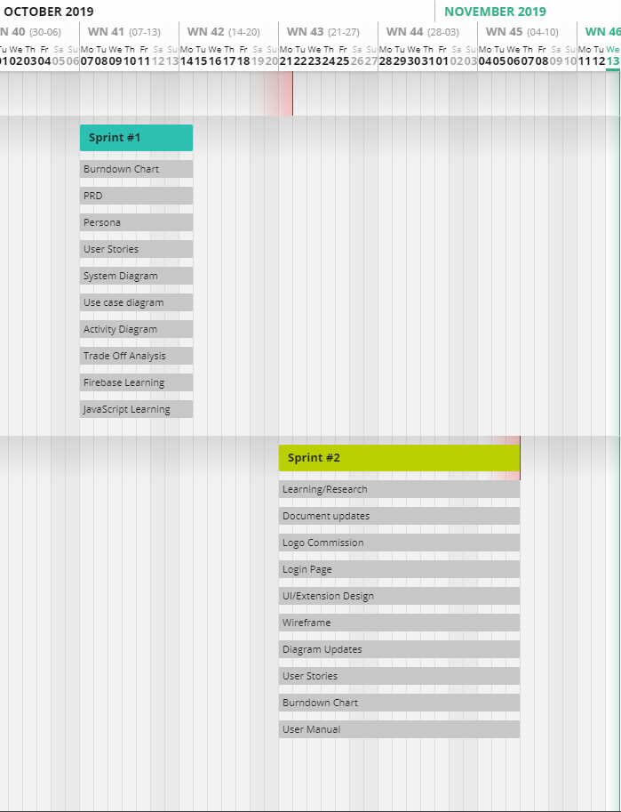
Gantt Chart

Slide 25
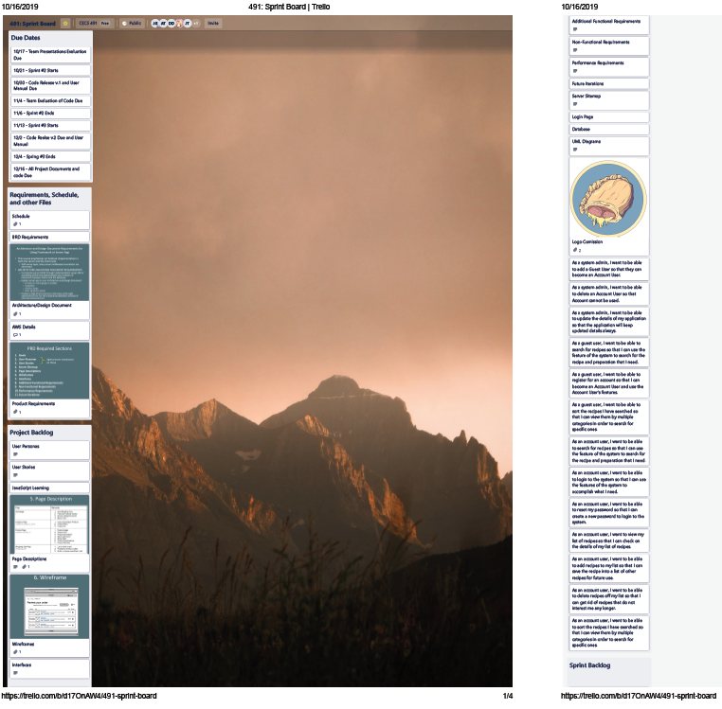
Sprint Board-Before
Notes:
Alex

Slide 26
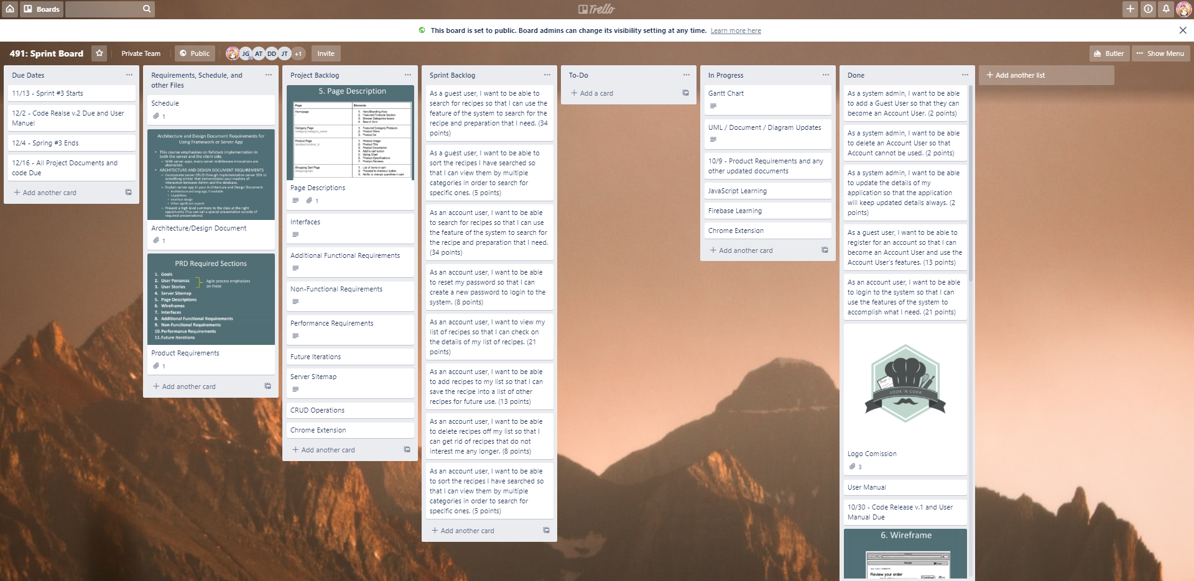
Sprint Board-After
Notes:
Alex

Slide 27
Sprint Retrospective
Did we meet our Sprint Goal?
Yes, our primary focus was developing the login page and a working database
What worked well/Didn’t work well?
Use of Firebase was easy and allowed us to use the database for login without causing any problems
What caused problems?
Focused too much on homework assignments, didn’t put as much time into improving UI and look of webpage
How to improve for next sprint/Conclusions
Try to manage our time better to put more work into the application
Notes:
Alex

Slide 28

Plans for the next sprint
Improve UI and look of webpage
Conduct more research about Machine Learning models and which we can use
Notes:
Alex

